Slide 1

B.L.D.E.A's V.P. DR. P.G. HALAKATTI COLLEGE OF ENGINEERINGAND TECHNOLOGY,
VIJAYAPUR – 586103
department of:
information Science & Engineering
PRESENTATION ON:
“STUDENT PERFORMANCE ANALYSIS”
GUIDED BY:
Dr . DANESHWARI NOOLA
SUBMITTED BY
Bhagyashree.S.Patil (2BL21IS007)
Kavita.M (2BL21IS015)
Sanjana.R (2BL21IS043)

Slide 2
SLNO | CHAPTERS
1. | INTRODUCTION
2. | LITERATURE SUREVEY
3. | SOFTWARE REQUIREMENTS
4. 4.1 4.2 | PROPOSED METHODOLOGY METHODOLOGY 1 METHODOLOGY 2
5. 5.1 | IMPLEMENTATION USE CASE DIAGRAM
6. | TESTING
7. | RESULT AND DISCUSSION
8. | MERITS AND DEMERITS
9. | CONCLUSION AND FUTURE SCOPE
10. | REFERENCES

Slide 3
INTRODUCTION
In the modern educational system, tracking and managing student performance is a critical aspect of ensuring that students achieve their academic goals and receive necessary support where needed.
Traditional methods of handling student records such as paper files or basic spreadsheets are not only time-consuming but also prone to errors, inefficiencies, and data security risks.
In light of these challenges, digital solutions have gained prominence for offering streamlined, reliable, and secure management of educational data. This project focuses on developing a Student Performance Management System to enhance the way academic institutions monitor student performance.
The primary goal of this project is to create a web-based system that simplifies the process of recording, updating, and viewing student performance data. The system is designed with two distinct access levels to cater to different user needs.
Student access allows students to log in and check their academic performance, including detailed marks and CGPA reports. This feature empowers students to stay informed about their progress, identify areas for improvement, and set academic goals.
In contrast, faculty access provides authorized staff with advanced capabilities to insert, update, and manage performance data efficiently. Faculty members can easily add new entries, modify existing records, and retrieve student performance information for better academic oversight.

Slide 4
The system is built using modern web development technologies including Node.js, Express, MongoDB and Frontend Framework to ensure a responsive, secure and scalable application. Node.js and Express serve as the backend framework, allowing for efficient data handling and API management, while MongoDB offers a robust, flexible database solution.
On the frontend, HTML and JavaScript ensures a dynamic user interface that is both intuitive and user-friendly. This combination of technologies not only provides high performance but also allows for future scalability as the system expands to accommodate additional features.
By leveraging a secure login mechanism, the system ensures that student data remains confidential and is only accessible to authorized users.
Role-based authentication is implemented to control access to specific functionalities, ensuring that students and faculty members can only interact with the data relevant to their roles. This helps maintain data integrity and privacy, addressing a major concern in educational data management.

Slide 5
LITERATURE SURVEY
The Student Performance Management System (SPMS) is an evolving field within educational technology aimed at improving the efficiency, accuracy, and security of academic record management.
In paper [1], This paper introduces the Student Performance Analysis System (SPAS), developed to monitor and predict student outcomes within the Faculty of Computer VISVESVARAYATECHNOLOGICAL UNIVERSITY, BELAGAVI-590018 Science and Information Technology (FCSIT).
In paper [2], This study examines the effectiveness of performance management tools in enhancing educational outcomes. Employing a mixed-methods approach, the research gathers insights from educators, administrators, and decision-makers to assess the impact of performance management systems

Slide 6
In paper [3], This research focuses on developing an effective and affordable student management system by incorporating a programmable device programming system. The proposed system aims to streamline administrative tasks and improve data accuracy within educational institutions.
In paper [4], This paper discusses the development of a system that enables teachers to easily track and maintain the overall performance status of each student.
The system includes features for attendance monitoring and performance analysis, providing educators with comprehensive insights into student progress.
In paper [5], This study proposes a learning management system integrated with an advanced educational mining module designed to efficiently extract knowledge from student performance record

Slide 7
PROBLEM DEFINATION(STATEMENT)
The lack of an efficient and automated system for tracking student performance in educational institutions leads to difficulties in managing academic records, identifying struggling students, and making data-driven decisions. Traditional methods are time-consuming, prone to errors, and do not provide real-time insights. There is a need for a web-based Student Performance Management System that allows students to track their academic progress, enables faculty to efficiently manage student records, and ensures data security and accessibility. The proposed system will leverage modern web technologies to enhance efficiency, reduce workload, and provide valuable performance analytics for better academic decision-making.

Slide 8
Manual Data Entry
Lack of Real-Time Analysis
Limited Accessibility
Security Risks
Scalability Issues

Slide 9
SOFTWARE REQUIREMENTS
1. Operating System:
Compatible: Windows 10, macOS, or Linux (Ubuntu recommended for server
environments)
The system should be capable of running Node.js, MongoDB, and other development
tools seamlessly.
2. Frontend Development Technologies:
HTML, CSS, JavaScript: Core technologies for building and styling web pages.
Browser Developer Tools: Use Chrome Dev Tools, Firefox Developer Tools, etc., for
debugging and performance testing.

Slide 10
3. Backend Development Technologies:
Node.js: JavaScript runtime environment for running the server.
Express.js: Lightweight web application framework for building RESTful APIs.
4. Database:
MongoDB: No SQL database for storing structured student performance data.
Install MongoDB Community Server.
Use MongoDB Compass (GUI tool) for visual database management.
5. Authentication:
JSON Web Token (JWT): For secure authentication and managing user sessions.
Install using npm: npm install jsonwebtoken

Slide 11
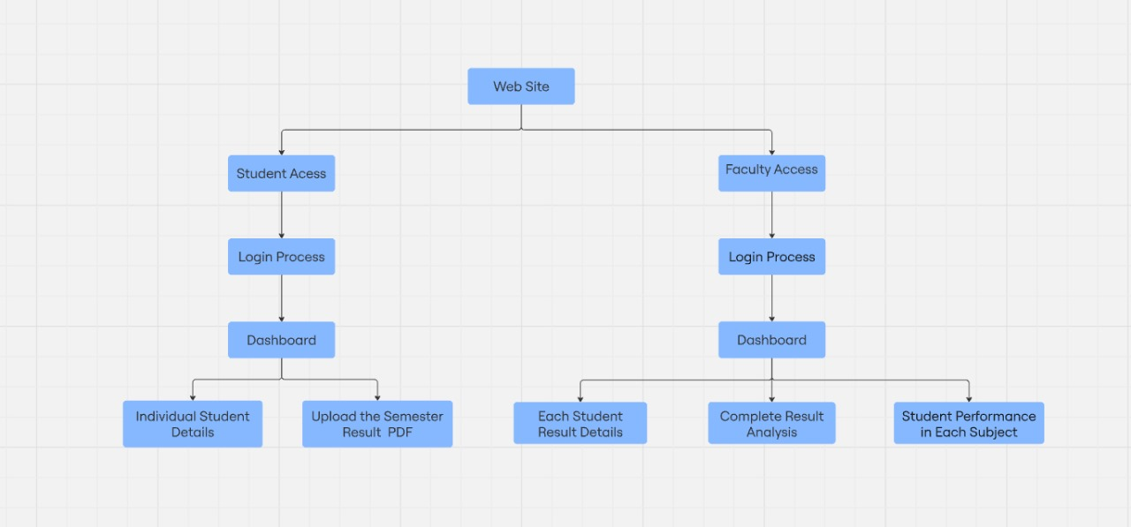
PROPOSED METHODOLOGY(BLOCK DIAGRAM)
Fig4.1: Methodology

Slide 12
Student Access:
This component likely addresses how students will interact with the web system.
Faculty Access:
Similar to student access, this pertains to how faculty members will engage with the system.
Login Process:
A secure method for users (both students and faculty) to log in to the web application.
Dashboard:
The central area where users will interact with the system once logged in. It serves as a hub for accessing functionalities.
Individual Student Details:
This component within the Student Access likely allows students to view and manage their personal information, such as contact details, enrollment status, and academic history.
Upload the Semester Result PDF:
This feature empowers faculty to upload official result documents in PDF format, making it accessible to students through the portal.

Slide 13
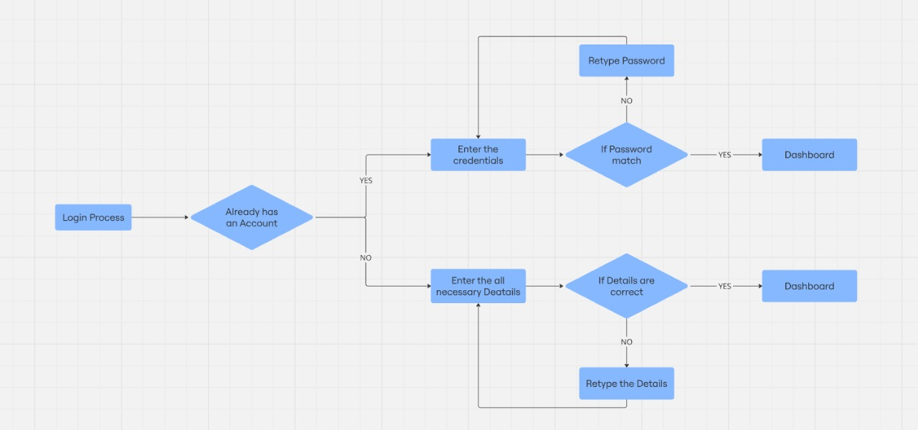
Fig 4.2: Methodology

Slide 14
Login Process: This is the starting point, indicating the user is initiating the process to access the system. It signifies the user's attempt to gain entry, presumably by providing credentials.
Already has an Account: This is a decision point where the system checks if the user is already registered. If the user has an existing account, they are directed to the login path. If not, they are guided through the registration process.
Enter the Credentials: This step involves the user providing their login information, typically a username and password. This is a crucial step where the user's identity is verified.
If Password match: Here, the system validates the entered password against the stored password associated with the provided username. This ensures that only authorized users gain access.
Retype Password: If the passwords don't match, the user is asked to re-enter their password, ensuring accuracy and preventing typos. This loop continues until a matching password is provided or the process is aborted.
Dashboard: Upon successful login (matching credentials), the user is granted access to their dashboard. This is a personalized area providing access to various features and information relevant to the user.
Enter the all necessary Details: This step is for new users registering an account. They are prompted to provide all required information, such as name, email, address, etc. This data is essential for creating a user profile.
If Details are correct: The system verifies the entered details for accuracy and completeness. This may include format checks, uniqueness checks, and other validations to ensure data integrity.

Slide 15
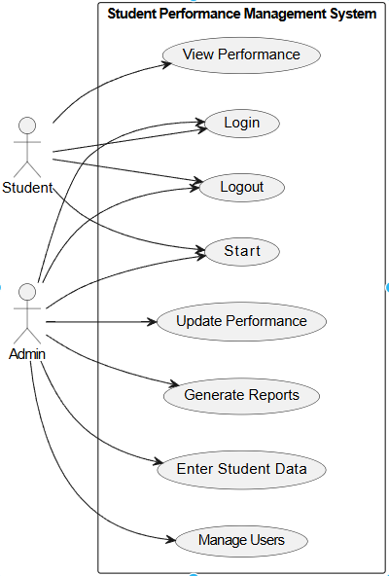
IMPLEMENTATION
Fig:5.1 Use case Diagram

Slide 16
The above figure is about the Use Case Diagram represents the interactions between the actors (Students and Admin) and the system functionalities.
MAIN MODULES (represented by the rounded rectangles/ovals):
View Performance: This module allows both students and administrators to view performance-related data. It's a core feature offering insights into academic progress.
Login: This is a fundamental module for user authentication. Both students and administrators must log in to access the system and its functionalities.
Logout: This module allows users to securely exit the system, ensuring data protection and session termination.
Start: This is a bit ambiguous without further context. It could imply starting a new academic session, course, or perhaps initiating a specific process within the system. It needs clarification to understand its exact purpose.
Enter Student Data: Another administrator-specific module, this allows for the input and management of student-related information within the system.
Manage Users: This module empowers administrators to manage user accounts, including creating new accounts, modifying existing ones, and potentially deactivating accounts.

Slide 17
SUB MODULES
View Individual Grades (Student): Access to specific grades for individual assignments, tests, and overall subject performance.
View Class/Overall Performance (Admin): Overview of class performance metrics, average scores, grade distribution, etc.
View Subject-wise Performance (Student/Admin): Performance analysis in specific subjects, including grades, progress over time, and comparisons.
Download Performance Reports (Student/Admin): Ability to download reports of performance data in various formats (PDF, CSV, etc.).
Update Performance (Admin):
Add New Performance Data: Inputting new grades, scores, or performance metrics for students.
Modify Existing Data: Editing or correcting previously entered performance data.
Import Performance Data: Uploading performance data in bulk from external files (e.g., spreadsheets).

Slide 18
TESTING
To ensure the efficiency and accuracy of the system, multiple testing techniques are applied:
1. Unit Testing
Each individual function (login authentication, data storage, API responses) is tested separately.
2. Integration Testing
Focuses on interactions between different components (frontend, backend, database).
3. System Testing
The complete system is tested to validate performance, functionality, and security.
4. Security Testing
Verifies that unauthorized users cannot access confidential student data.
Role-based access control is tested to ensure students can only view their own data, while faculty and admin have authorized access to modify records.

Slide 19
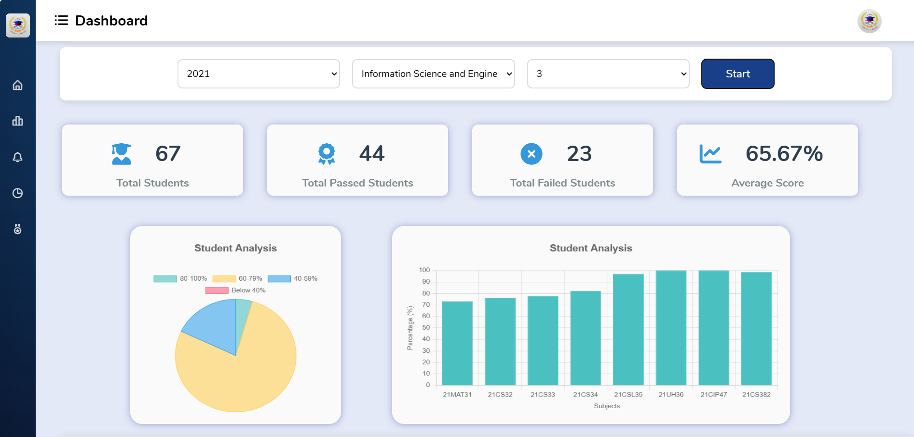
RESULTS
Fig 7.1: Admin Dashboard
Fig:7.1 Admin Dashboard

Slide 20
The above figure is about the Admin Dashboard. The Admin Dashboard acts as a centralized control panel, offering an overview of key metrics and navigation to essential functionalities.
It typically includes features such as student data management, performance tracking, report generation, and user role management.
The dashboard is designed to be user-friendly and efficient, enabling administrators to quickly access critical information, update records, and monitor system activities in real time.
Additionally, it may include graphical representations, charts, and notifications to provide insights into student performance trends.

Slide 21
MERITS AND DEMERITS
Merits:
Identifies Strengths and Weaknesses – Helps students and teachers understand areas where students excel and where improvement is needed.
Improves Teaching Strategies – Teachers can modify teaching methods based on performance trends.
Enhances Personalized Learning – Allows for tailored learning experiences based on individual student needs.
Demerits:
Stress and Pressure – Continuous evaluation may create anxiety and undue pressure on students.
May Not Reflect True Potential – Some students struggle with exams but excel in practical skills, which may not be captured in traditional assessments.
Risk of Bias – Analysis may be influenced by subjective grading, favoritism, or systemic bias.

Slide 22
CONCLUSION AND FUTURE SCOPE
Conclusion
Features like automated attendance tracking can establish a correlation between student presence and academic performance, while a dedicated mobile application can provide real-time access to performance data for students and administrators.
Additionally, incorporating gamification elements can boost student engagement and motivation.
Future scope
In Future scope, the Student Performance Management System :-
AI-Driven Predictive Analysis: Machine Learning model with predict student outcomes based on historical performance attendance and engagement.and Early identification of at risk students for timely intervention.
Personalized Learning & Adaptive Systems: AI-powered system will tailor learning experiences to individual students needs. and Dynamic curriculum recommendations based on performance trend.
Real-Time Performance Monitoring: IOT and wearable tech could track students engagement and stress levels. And Automated feedback system will provide instant insights to teachers and students.

Slide 23
REFERENCES
"An Effective Learning Management System for Revealing Student Performance Attributes", Xinyu Zhang, Vincent C.S. Lee, Duo Xu, Jun Chen, Mohammad S. Obaidat, 2024
"A Research Paper on College Management System", Lalit Mohan Joshi, Dr. M. Venkatesan, M. Deepak Kumar, S. Mahesh Kumar, K. Manikandan, 2015
"An Innovative Information System for College Management", Chaitra Gemini, Dr. S. Priyanka, A. Anand, Obaidat, 2020
"A Review on College Management System", Ms. G. G. Gore, Dr. Rajesh Kumar, K. Vignesh, P. Shanmugam, Mr. P. D. Dhumal, 2021
"Improve a College Management System Based Mobile Application", Kumar, S. Mahesh Kumar, K. Manikandan Xinyu Zhang, Mohammad S, 2020

Slide 24
THANK YOU

